Slide 1
Mastering Rapid Power BI Development with ChatGPT
Pedro Reis
Ricardo Santos

Slide 2

Impact of AI on Knowledge Workers
Study on AI at BCG with 1500 Professionals
25%
Faster to complete tasks by using AI
40%
Higher quality results using AI
Source: Navigating the Jagged Technological Frontier: Field Experimental Evidence of the Effects of AI on Knowledge Worker Productivity and Quality
Harvard Business School Technology & Operations Mgt. Unit Working Paper No. 24-013
Notes:
AI has come, and it’s irrevocably altering the landscape of our work. Those who master it will shape the future, while the unprepared could be rendered obsolete. For Power BI Developers and Information Workers, this is the dawn of a new epoch. A recent study from BCG, involving 1,500 professionals, illuminates this transformation.
The participants, ranging from novices to seasoned professionals, engaged in tasks designed to mirror the analytical rigor of their daily roles. They were divided, some working unaided, while others collaborated with AI. The AI-assisted group demonstrated a significant performance leap, completing tasks with a 12.2% increase in speed. Quality, the paramount measure, improved by 40% within AI's capability frontier. But, beyond this frontier, the reliance on AI saw a 19% decrease in correct solutions.
This study offers more than just statistics. It narrates the rise of a new partnership between humans and AI. The Centaurs, strategic collaborators with AI, tactically divided labor, harnessing AI's prowess for data-heavy tasks while preserving the human touch for nuanced analysis. The Cyborgs, on the other hand, integrated AI more deeply, blurring the lines between human intuition and machine efficiency.

Slide 3

Who can this help?
SQL and BI Professionals need to tweek some M or DAX
Power BI / Citizen Developers / SME Lacking coding expertise
Professionals lacking UI / UX skills or in need of inspiration
Occasional usage for productivity or direction pointer

Slide 4



About the speakers
Pedro Reis
Ricardo Castro Santos
Microsoft MVP, MCT
Expert Leader Data & AI @Natixis
Leader of Fabric Power BI Portugal Group
Founder www.fabricbi.net
Expert Leader - BI & Big Data
@ Big Data & Architecture – Natixis
VP APBI – Portuguese Association for Business Intelligence
MCSE – Data Management & Analytics
pedroreis@reispm.onmicrosoft.com
https://www.linkedin.com/in/pedrogoncalvesreis/
rjcsantos@hotmail.com
https://www.linkedin.com/in/rickcsantos

Slide 5
Agenda and content slides
Data Modeling & Analysis
Generate Artificial Data
Generate Power Query code
Generate DAX Measures & CSS
Generate Imaging for the report
Generate Tabular Editor Scripts
Cmdlets / PowerShell Scripts
Key Takeaways / The Future

Slide 6

Test OK
Test OK
with iterations or limitations
Test KO

Slide 7

1) Data Modeling & Analysis
Generate a Data Model
Analyze a Data Model
Analyze Data

Slide 8

2) Generate Artificial Data
Generate CSV Files
Generate Py Script which generates CSV Files
Generate T-SQL Script which generates and populates Database

Slide 9

3) Generate Power Query code
Generate Calendar
Create Custom Columns
Create Custom Functions
Translate Calendar

Slide 10
4) Generate DAX
Create Measures
Create Calculation Groups
DAX + CSS

Slide 11
5) Generate Report Imaging
Banner / Background
Placeholders / Symbols
Theme

Slide 12

6) Generate Tabular Editor Scripts
Generate Measures
Rename Columns and Measures

Slide 13

7) Cmdlets / PowerShell Scripts
List PBI Workspace Artifacts
Backup Models and Reports
Deployment

Slide 14

8) Key Takeaways / The Future
Summary Table
Key Takeaways
The Future

Slide 15
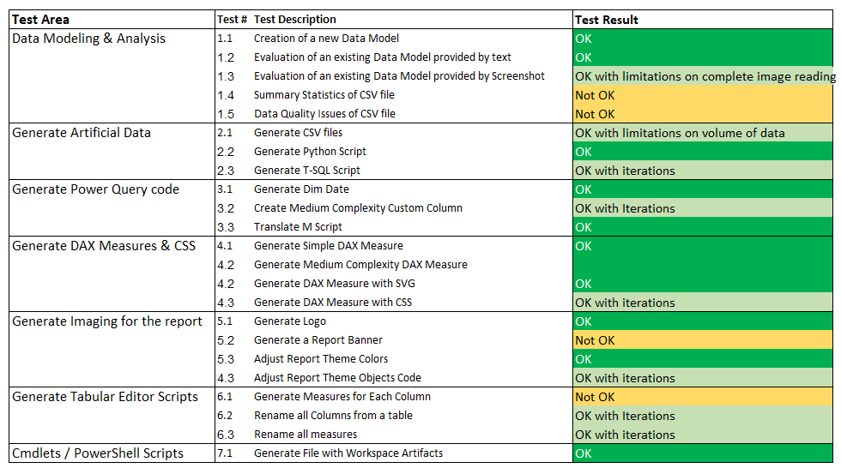
Results Summary

Slide 16
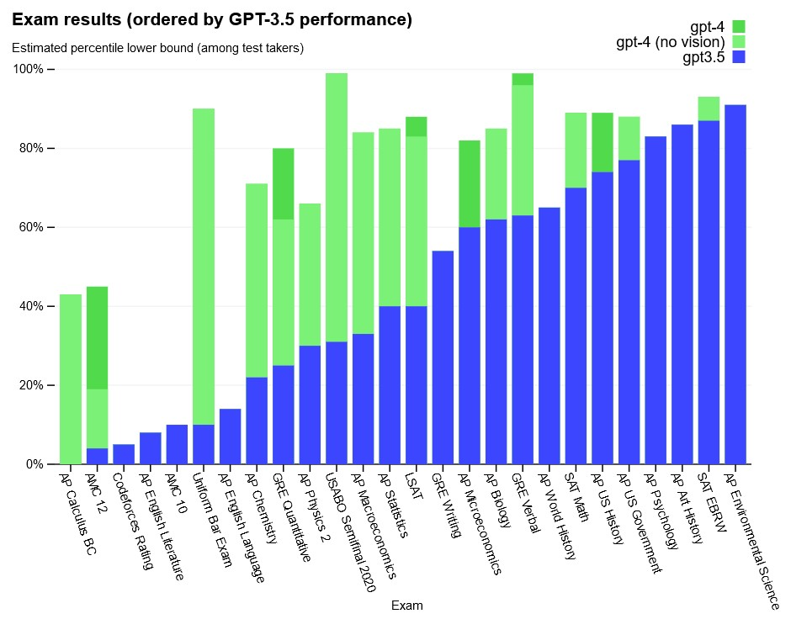
Exam Scores by GPT 3.5 and GPT 4

Slide 17
8) Key Takeaways / The Future
Far from perfect but points in the correct direction and possible to get to a working version by iterating requests, output and errors.
Works like a Junior level assistent, which confirms results of BGG study for Power BI also.
Will tend to improve quickly (same way as test results improved from GPT 3.5 to GPT 4.0)
PBIP Format should greatly enhance interaction capabilities
Likely see it not only in DAX but in Power Query,
Administration, Design and much more

Slide 18


Thank you!
Connect with us:
rjcsantos@hotmail.com
https://www.linkedin.com/in/rickcsantos
pedroreis@reispm.onmicrosoft.com
https://www.linkedin.com/in/pedrogoncalvesreis/
www.fabricbi.net/

Slide 19















